Slide 1
Seamless integration between design and analysis of thin-walled structures
PI: Hugo Casquero, University of Michigan - Dearborn
Email: casquero@umich.edu
Team: Mahmoud Golestanian (PhD Student), Zuowei Wen (PhD Student)

Slide 2
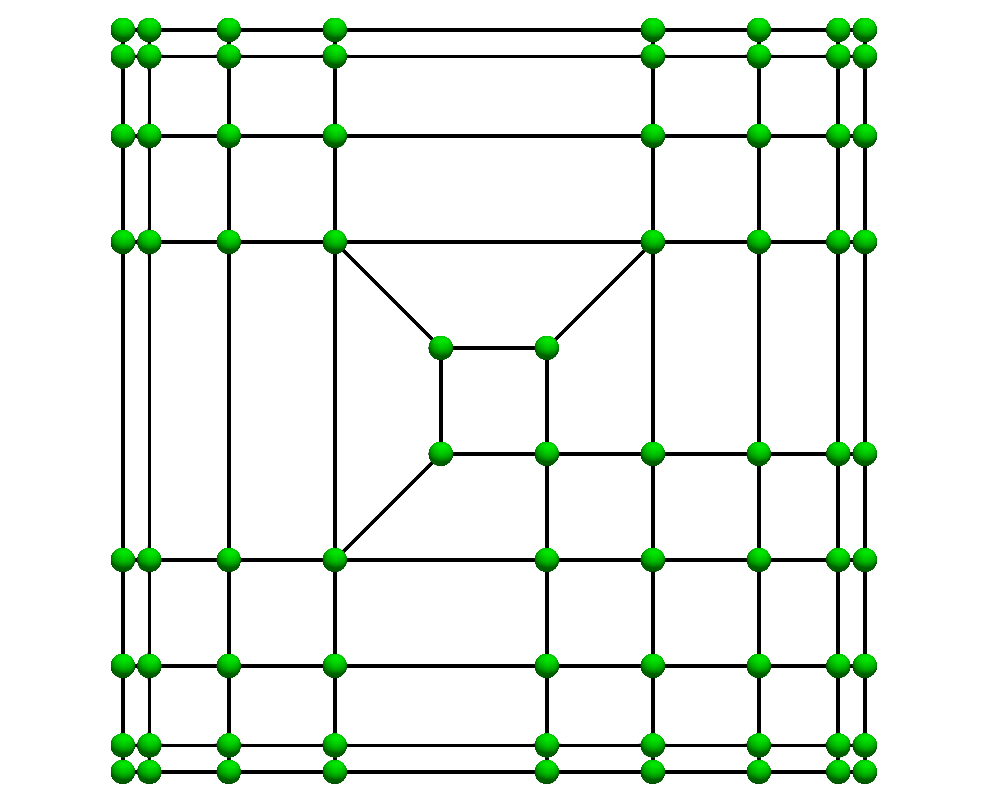
Task 1: Keep improving the quadtospline code based on AST-splines
The valence of a vertex is the number of edges that emanate from that vertex.
Extraordinary points are either interior vertices with a valence greater than 4 that are not T-junctions or boundary vertices with a valence greater than 3. Extraordinary points are necessary to build spline geometries with arbitrary topology.
Until now, extraordinary points needed to be 3 rings apart from each other in AST-splines. We eliminated this requirement two months ago. This is a significant improvement !!
Control net that has some elements with various extraordinary points (for some elements, the four vertices are extraordinary points).
We will perform global refinement and compute the convergence rates for the Poisson and biharmonic equation to verify that our spline spaces have optimal approximation properties.

Slide 3
Convergence rates for AST-splines with various extraordinary points per element
Poisson equation
The convergence rates in all norms are optimal !!

Slide 4
Convergence rates for AST-splines with various extraordinary points per element
Biharmonic equation
The convergence rates in all norms are optimal !!
We have also mathematically proven linear independence and non-negative partition of unity, so it is time to build some complex geometries !!

Slide 5
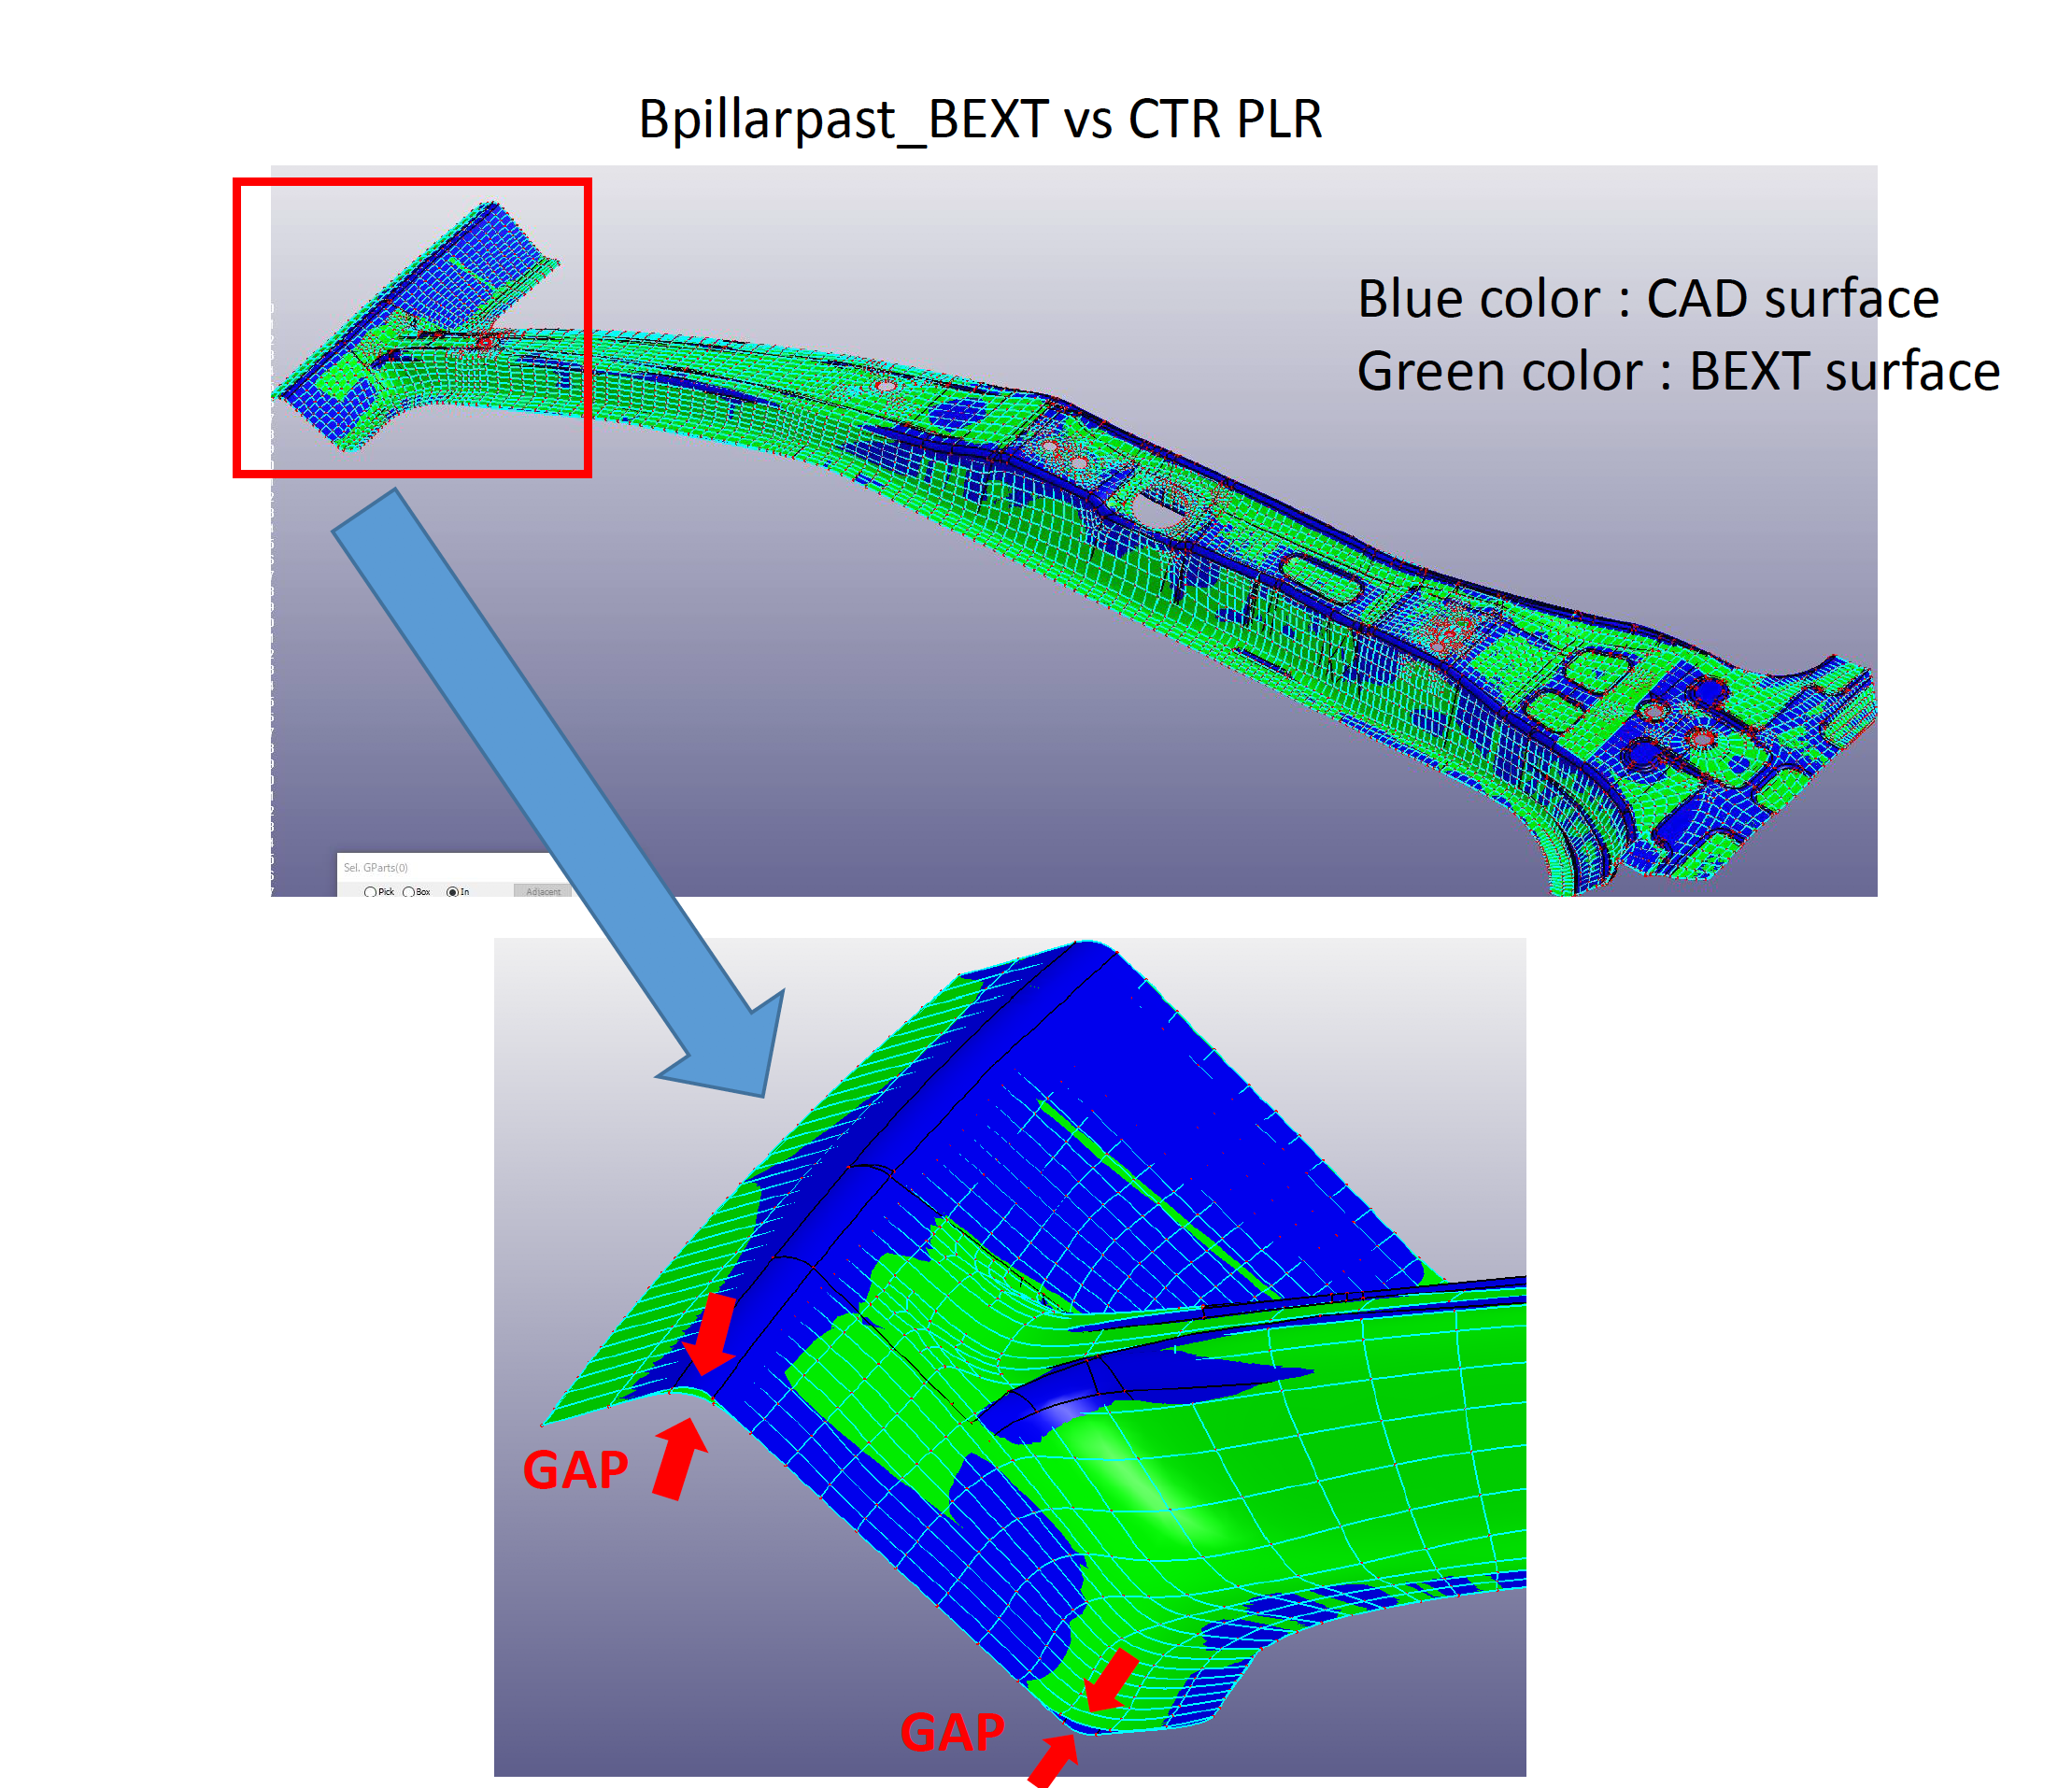
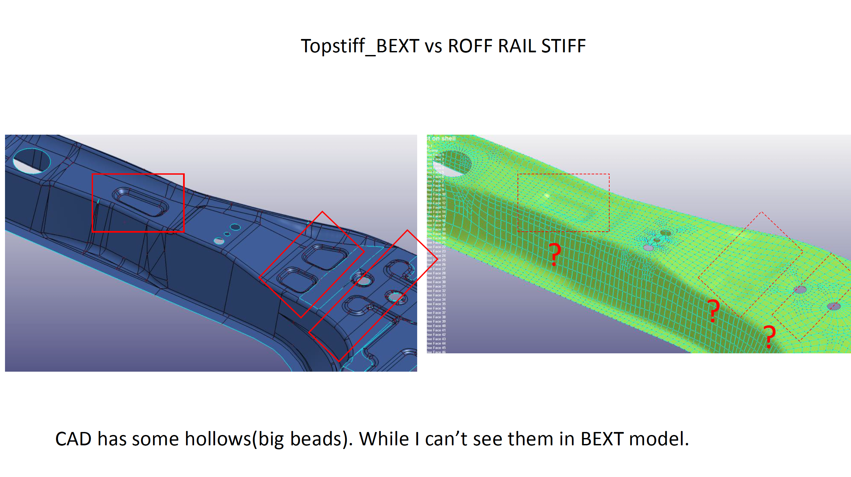
B-pillar designed using T-splines in Autodesk Fusion360
On October 10, 2019, Kenji mentioned that there were big differences between CAD and BEXT geometries. These differences disappear when the geometry is designed in Autodesk Fusion360 using T-splines and automatically transferred into a BEXT file to use it in LS-DYNA.

Slide 6
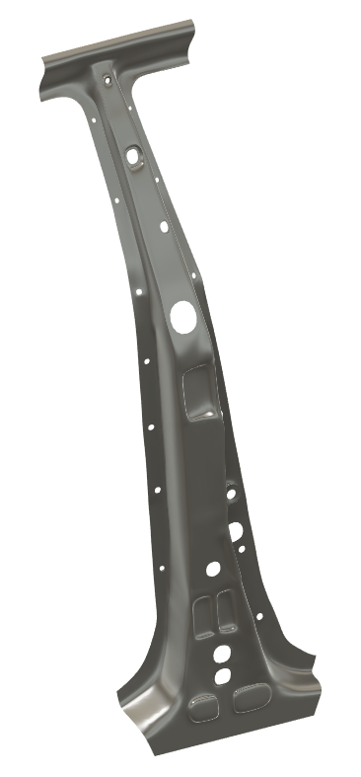
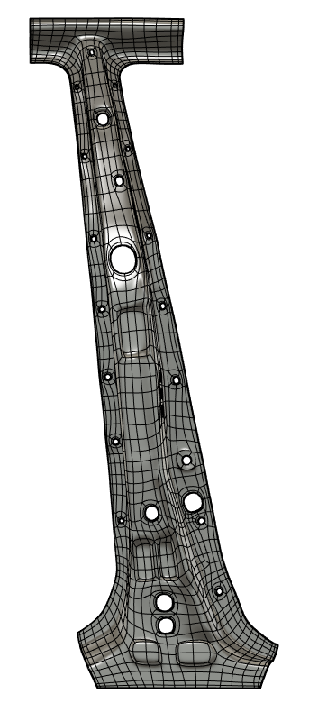
B-pillar designed using T-splines in Autodesk Fusion360
T-spline surface including face boundaries to see the extraordinary points (vertices with valence 3, 5, and 6).
T-spline surface designed from scratch
Only 3507 control points !!!

Slide 7
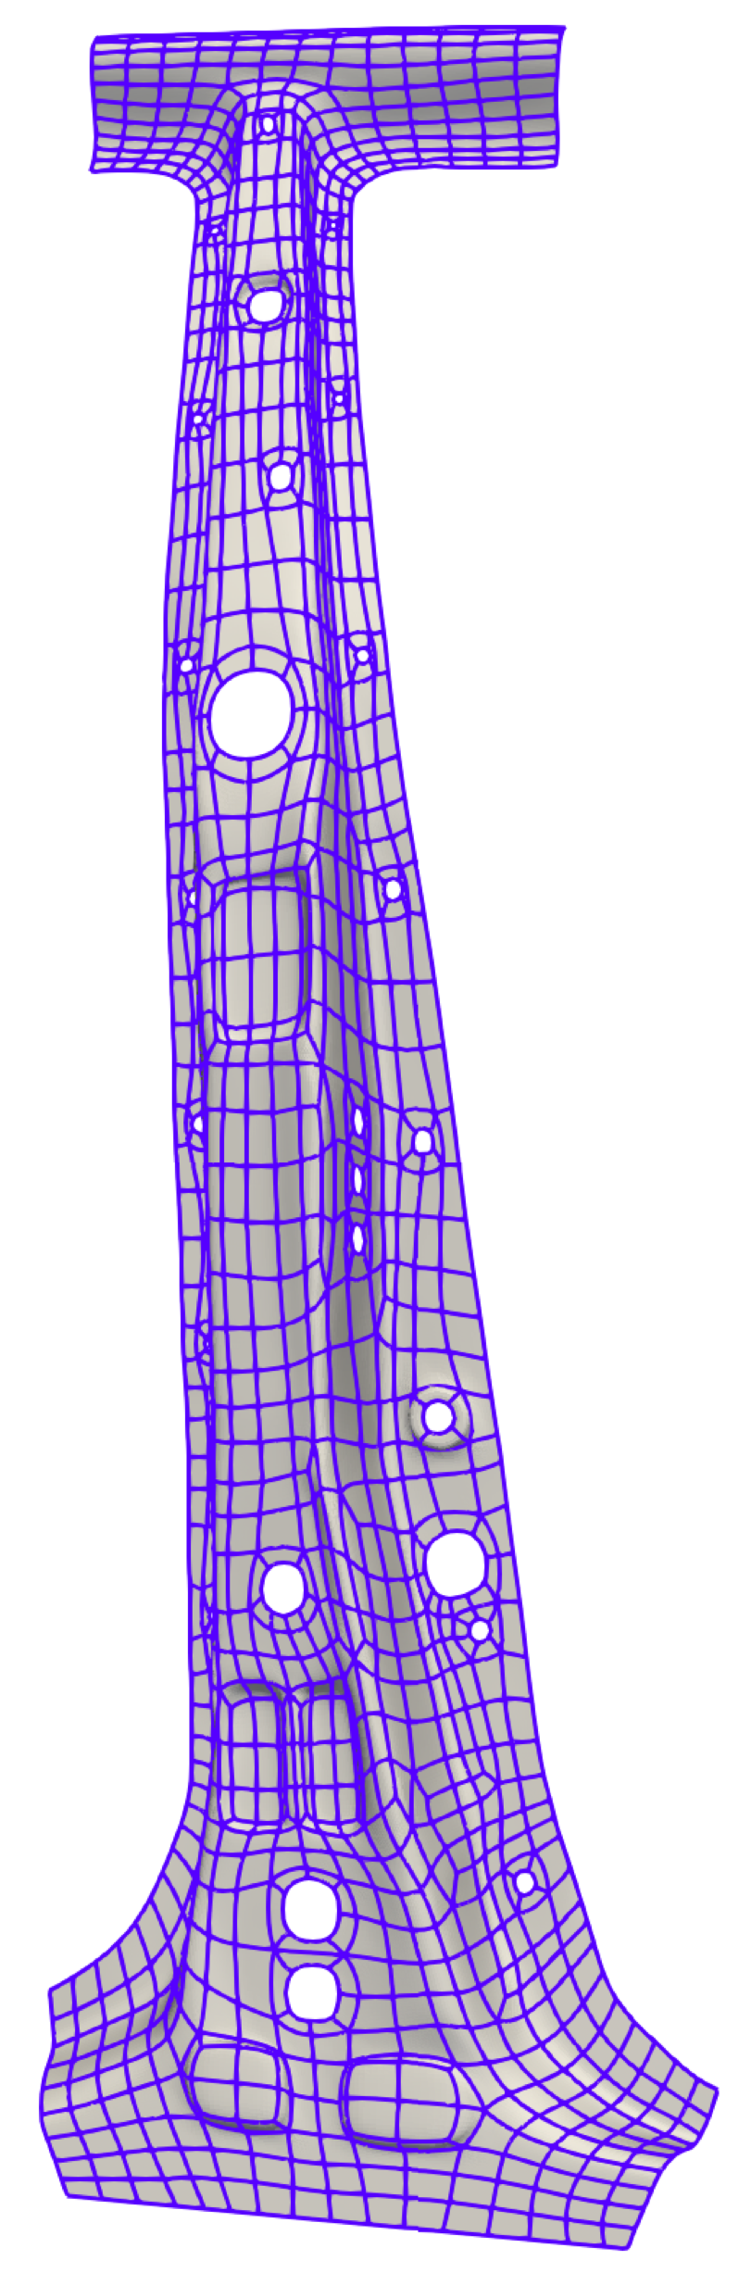
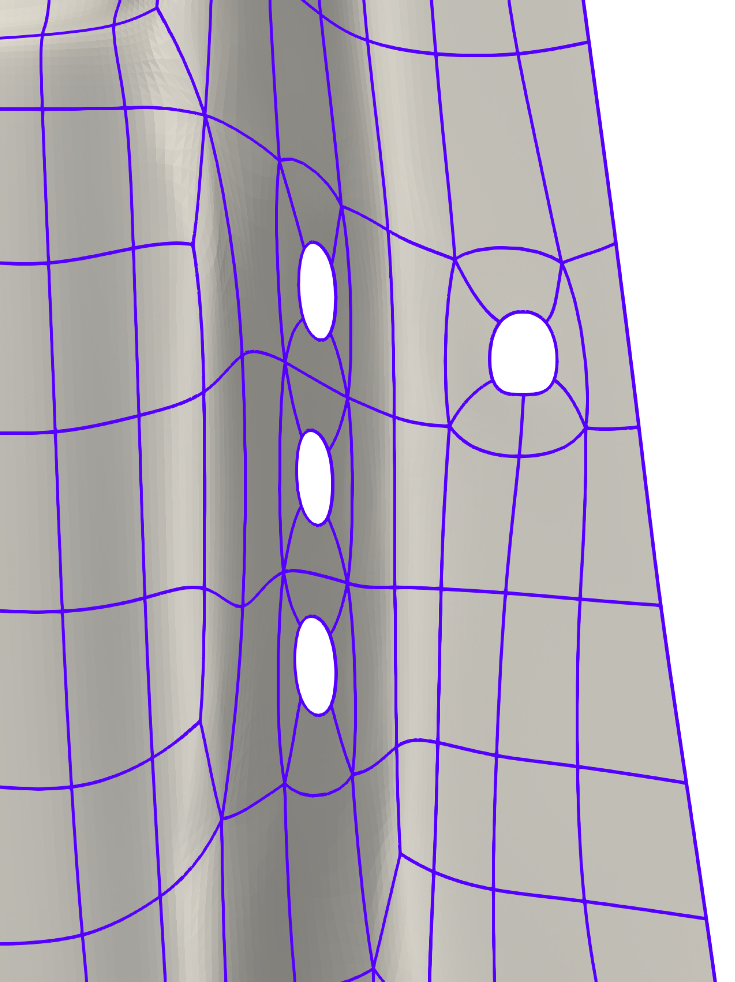
B-pillar designed using T-splines in Autodesk Fusion360
The zoom-in region shows faces with various extraordinary points !!
The BEXT geometry is obtained
using our in-house code quadtospline.exe using the control net as input. This is automatic, it takes 30 seconds !!
BEXT geometry
Only 3507 control points !!

Slide 8
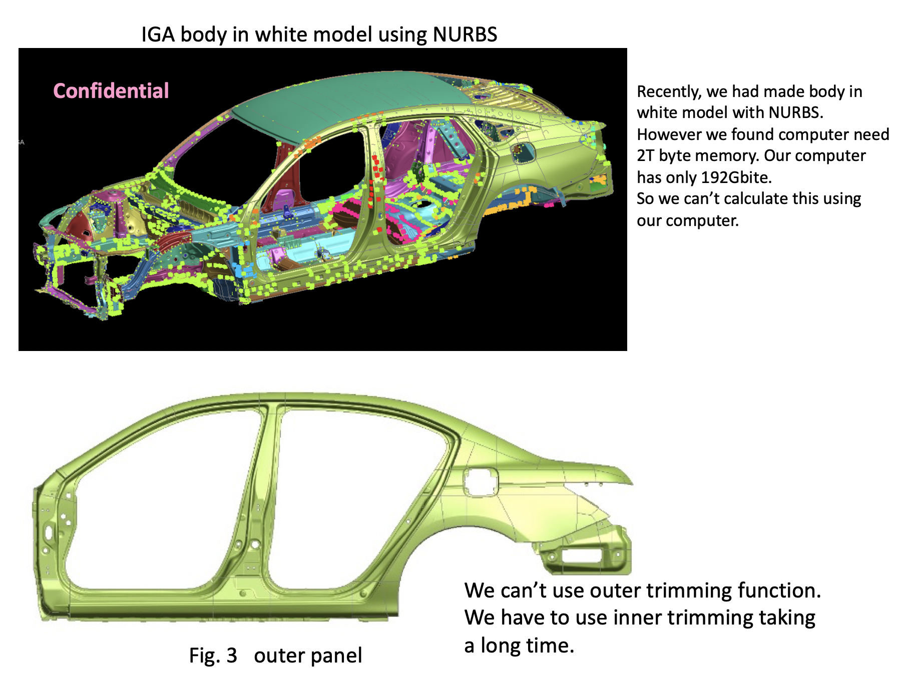
Side outer panel designed using T-splines in Autodesk Fusion360
On January 15, 2020, Kenji asked to find a way to build boundary-fitted IGA meshes for geometries as complex as the side outer panel to use as an alternative to trimmed NURBS.

Slide 9
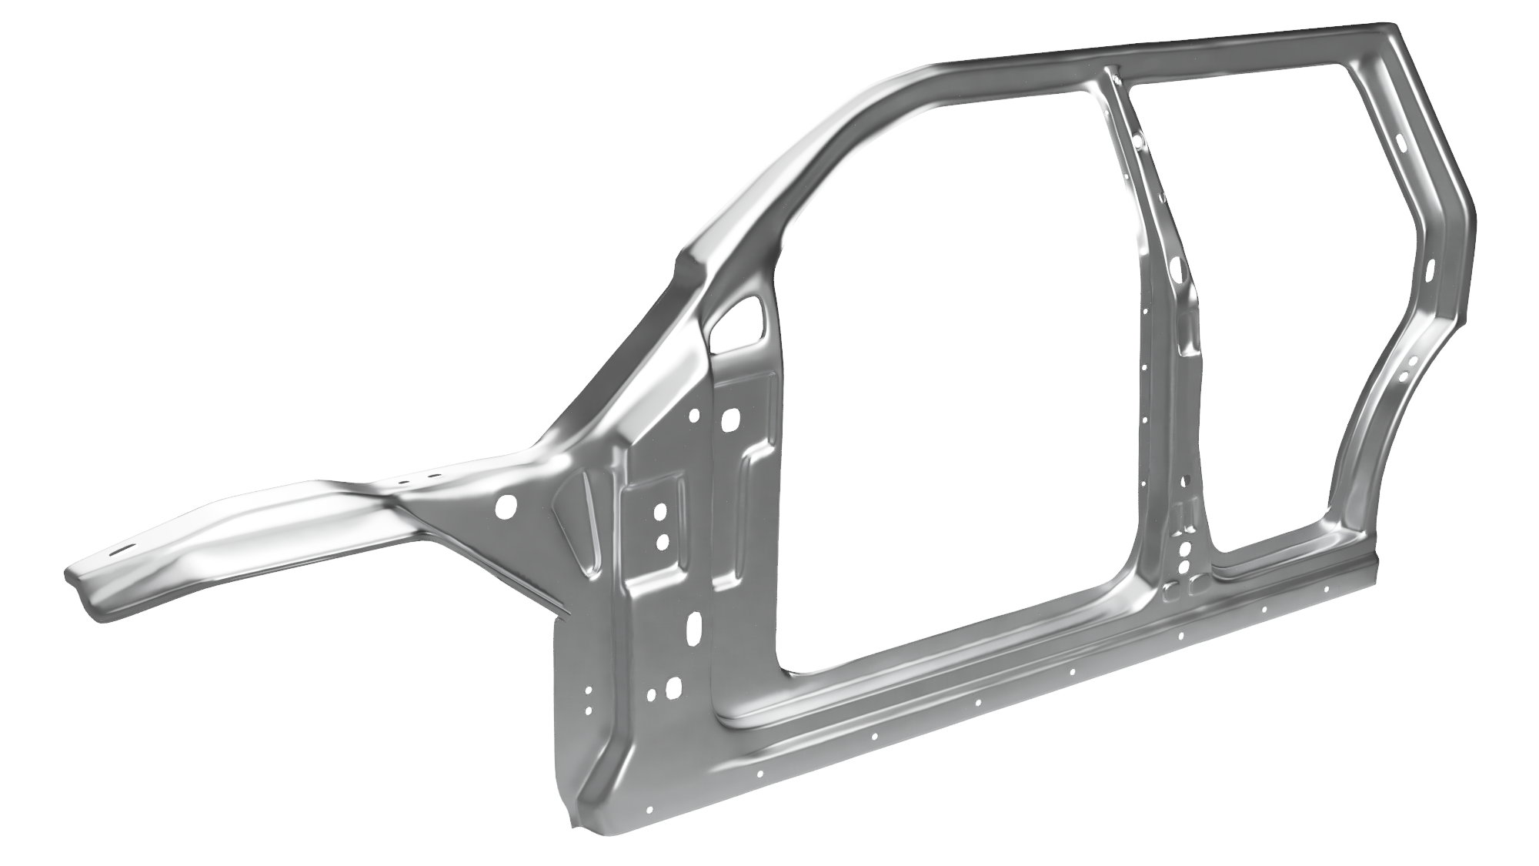
Side outer panel designed using T-splines in Autodesk Fusion360
Only 8409 control points !!
T-spline surface designed from scratch. This is CAD geometry !!
(We built a completely different geometry than the confidential geometry that Kenji sent us so that we can include this geometry in our research paper)
Rendered view

Slide 10
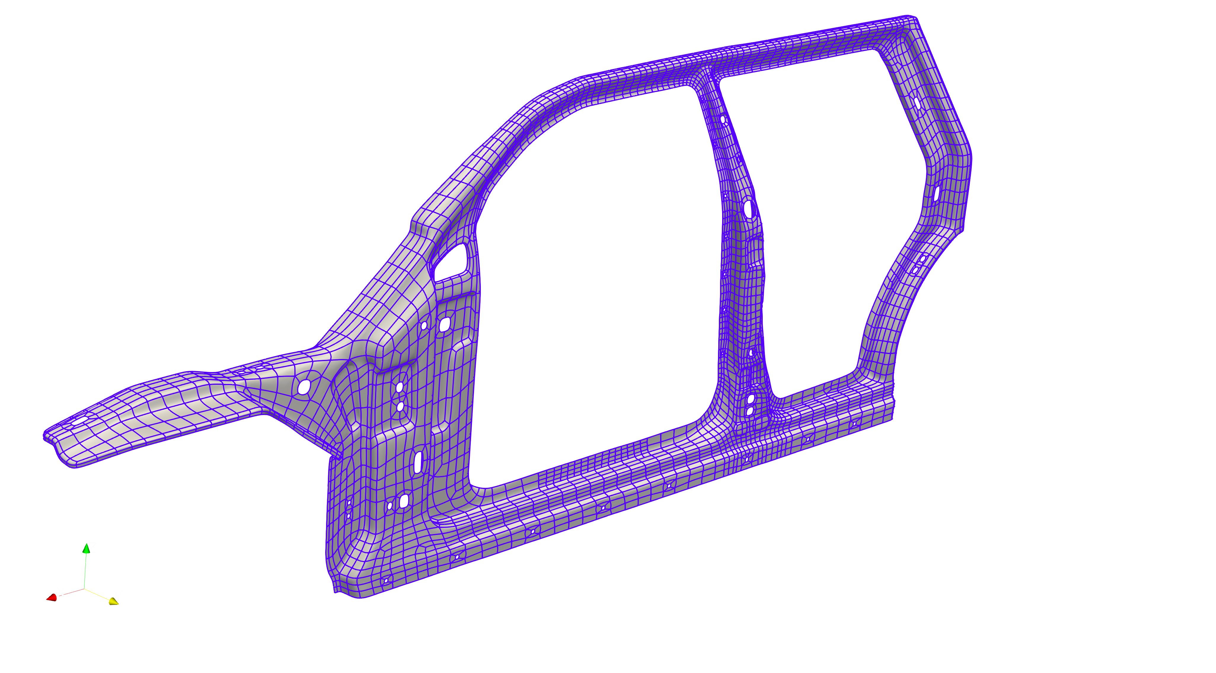
Side outer panel designed using T-splines in Autodesk Fusion360
BEXT geometry that can be used in LS-DYNA
Only 8409 control points !!
AST-spline surface including faces boundaries to see the extraordinary points (vertices with valence 3, 5, and 6).
This is the most complex IGA geometry built so far using only one spline surface (as opposed to use thousands of patches which is the case when using NURBS).

Slide 11
From CAD geometry using trimmed NURBS in CATIA to AST-spline geometry to use in LS-DYNA
Honda already has many CAD geometries done in CATIA using trimmed NURBS. Therefore, Honda cannot always design a CAD geometry using T-splines in Fusion360.
Honda needs a way to use our in-house code quadtospline.exe starting from the CAD geometries done in CATIA using trimmed NURBS.
The developer version of Rhino (version 7) has a new command (QuadRemesh) that enables to obtain a high-quality quad mesh using a CAD geometry based on trimmed NURBS as input. In addition, Rhino can convert the quad mesh to SubD (SubD is a type of CAD geometry not suitable for analysis directly). Then, the SubD can be fitted to the original CAD geometry based on trimmed NURBS to minimize geometric differences. Finally, the control net of the SubD can be exported using the command ExtractControlPolygon. This control net can be used as an input in our in-house code to obtain an AST-spline surface in BEXT format to do simulations in LS-DYNA. All this process is automatic, it takes 4 minutes. This enables Honda to use quadtospline.exe starting from a CAD geometry done in CATIA using trimmed NURBS while we study other options in this project. We will study using the frame-field method to obtain our own quad meshes and develop our own fitting algorithms to minimize geometric differences.

Slide 12
Keep improving the in-house code quadtospline.exe
Extrude AST-spline surfaces in the through-thickness direction to obtain a volumetric spline mesh that can be used with IGA solids in LS-DYNA.
Update how the Bezier extraction information is written to support the new format LS-DYNA is working on (IGA_INCLUDE_BEZIER).
Currently, the control net given as an input to quadtospline.exe must not have extraordinary points in the 0- and 1-layer vertices around the boundary of the control net. We will study constructions of extraordinary points that are analysis suitable for the 0- and 1-layer vertices around the boundary of the control net to eliminate this requirement.
Currently, the 1-ring faces of extraordinary points need to be split in 2x2 Bezier elements in order to build basis functions that are analysis suitable around extraordinary points. We will study alternative constructions around extraordinary points that do not need this 2x2 split while preserving optimal approximation properties, linear independence, non-negative partition of unity, etc. This would enable to build uniform Bezier meshes throughout geometries with arbitrary topological genus.

Slide 13
Task 2: Remove locking in spline meshes
Splines (IGA) suffer from the same types of locking as Lagrange polynomials (FEM), namely, membrane locking, transverse shear locking, and curvature-thickness locking.
For both splines and Lagrange polynomials, locking is alleviated by increasing the polynomial degree, but for very coarse meshes, locking is still present !!
Complex geometries (body in white, side outer panel, B-pillar, etc.) require to use very coarse meshes to have acceptable computational times. Therefore, treating locking is very important !!
For FEM, there are plenty of methods to deal with locking, namely, Assumed Natural Strain (ANS), Enhanced Assumed Strain (EAS), element-based reduced and selective reduced integration, etc., these methods are not effective for spline meshes. New methods are needed !!
Key idea for the methods that I plan to develop to deal with locking in spline meshes: The projected strains need to be continuous throughout the geometry instead of being discontinuous at the element boundaries as in ANS, EAS, etc.
The methods will work for both NURBS and AST-splines.

Slide 14
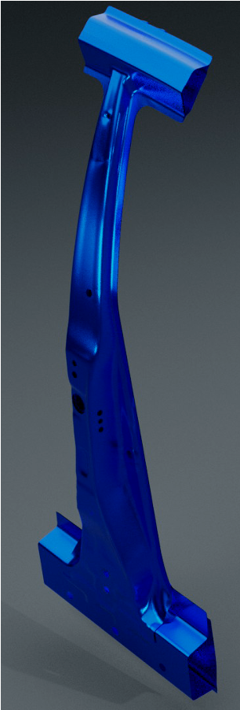
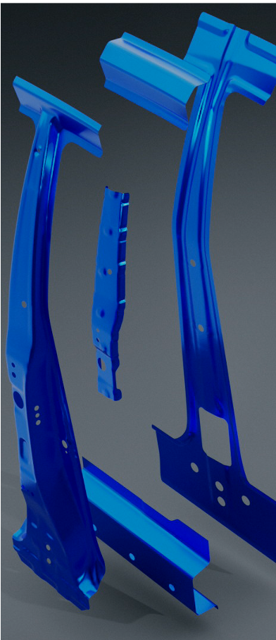
Task 3: Develop a model of spot welds for IGA solids
LS-DYNA has currently models of spot welds for IGA shells, but not for IGA solids.
Crash simulations done by Honda in LS-DYNA using BEXT meshes for five components connected by spot welds.
IGA shells were used to have realistic model of spot welds.
In the future, we can use 5 elements for nugget with 4 extraordinary points with valence 3 and 4 or 8 elements for heat-affected zone.
Honda mentioned they want to try IGA solids for thin-walled structures to predict fracture accurately. A model of spot welds for IGA solids is needed !
Our recent breakthrough of allowing various extraordinary points per element is key to mesh with splines the nugget and heat-affected zone !!

Slide 15
6. Summary
Control nets: Two options to get them: (a) Use Rhino version 7 (namely, the new command QuadRemesh) to get a high-quality quad mesh using a NURBS-based CAD geometry as input. Then, we will study various fitting algorithms to minimize the geometric difference between the original NURBS-based CAD geometry that Honda builds using CATIA and the final AST-spline geometry that Honda will use in LS-DYNA to perform simulations (b) Design from scratch a CAD geometry using T-splines in Autodesk Fusion360 and extract the control net.
Spline basis functions: Built with in-house code, namely, quadtospline.exe which we will keep developing during this project so that it can take any control net with any configuration of extraordinary points as an input.
Locking: I will test methods with my in-house code. If I find a good solution, LS-DYNA may be interested in including this method in its software.
Spot welds: My PhD students and I will build spline meshes for the nugget, heat-affected zone, and remaining geometry so that Honda can define different material properties for these three regions in LS-DYNA and perform simulations in order to compare with the experimental data that Honda has.

